Slide 1


SCHOOL OF ELECTRONICS AND COMMUNICATION ENGINEERING
OOPS Project Ⅵ semester
Team members:
SL.NO | NAME | USN
1. | Shyam Desai | 01fe21bec110
2. | Shridhar Naragund | 01fe21bec116
Under the guidance of:
Sumita Guddin
Vimal N B

Slide 2

OVERVIEW
Introduction
Problem statement
Objectives
Proposed Methodology
Block diagram
Demonstration of results
Conclusion
School of Electronics and Communication Engineering

Slide 3
Introduction
The Flight Booking System for ABC Airlines is a C++ program designed to streamline and enhance the airline booking experience. Utilizing object-oriented programming, it addresses challenges in managing flight bookings, calculates fares based on various factors, and ensures a seamless process for users, contributing to a more efficient and user-friendly airline reservation system.
School of Electronics and Communication Engineering

Slide 4
Concepts used
Encapsulation:
Data members (origin, destination, fare, food & drinks) are encapsulated within the Flight class, limiting direct access from outside the class.
Access to these members is controlled through public methods and constructors.
Inheritance:
The Business and Economy classes inherit from the base class Flight.
Inheritance allows the derived classes to reuse and extend the functionality defined in the base class.
School of Electronics and Communication Engineering

Slide 5
Concepts used
Polymorphism:
The calculateFare() function is declared as a virtual function in the base Flight class.
The Business and Economy classes provide their own implementations of the calculateFare() function, demonstrating polymorphism.
The template function bookFlight utilizes polymorphism by accepting different types of flights.
School of Electronics and Communication Engineering

Slide 6
Problem statement
Flight Booking System:
The airline industry faces challenges in managing flight bookings efficiently and providing a seamless user experience. Existing systems may lack user-friendliness, struggle with accurate fare calculations, and encounter issues with exception handling. There is a need for an improved and reliable Flight Booking System to address these challenges and enhance the overall booking process for both airlines and passengers.
School of Electronics and Communication Engineering

Slide 7
Objectives
To provide passengers with a seamless and user-friendly booking experience.
To accurately calculate fares based on origin, destination, and class of travel.
To implement effective exception handling for user inputs.
To optimize code organization using object-oriented programming principles.
School of Electronics and Communication Engineering

Slide 8
Proposed Methodology
Class Hierarchy:
Implementing classes such as Flight, Business, and Economy to represent different flight types.
Utilizing inheritance to establish a clear class hierarchy.
2. Virtual Function:
Incorporating a virtual function, calculateFare(), within the base Flight class for polymorphic behavior.
School of Electronics and Communication Engineering

Slide 9
Proposed Methodology
4. User Input Handling:
Using exception handling to gracefully manage invalid user inputs for origin, destination, and class.
5. Fare Calculation:
Determining fares based on the origin, destination, and class of travel for accurate cost representation.
6. Tax and Additional Charges:
Incorporating tax calculations and additional charges for food/drinks to provide a comprehensive fare calculation.
School of Electronics and Communication Engineering

Slide 10
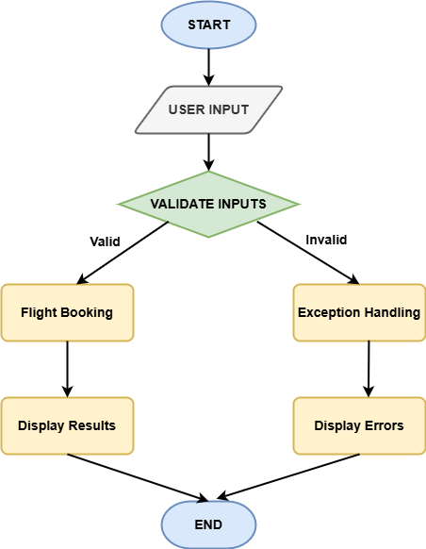
Block Diagram
School of Electronics and Communication Engineering

Slide 11
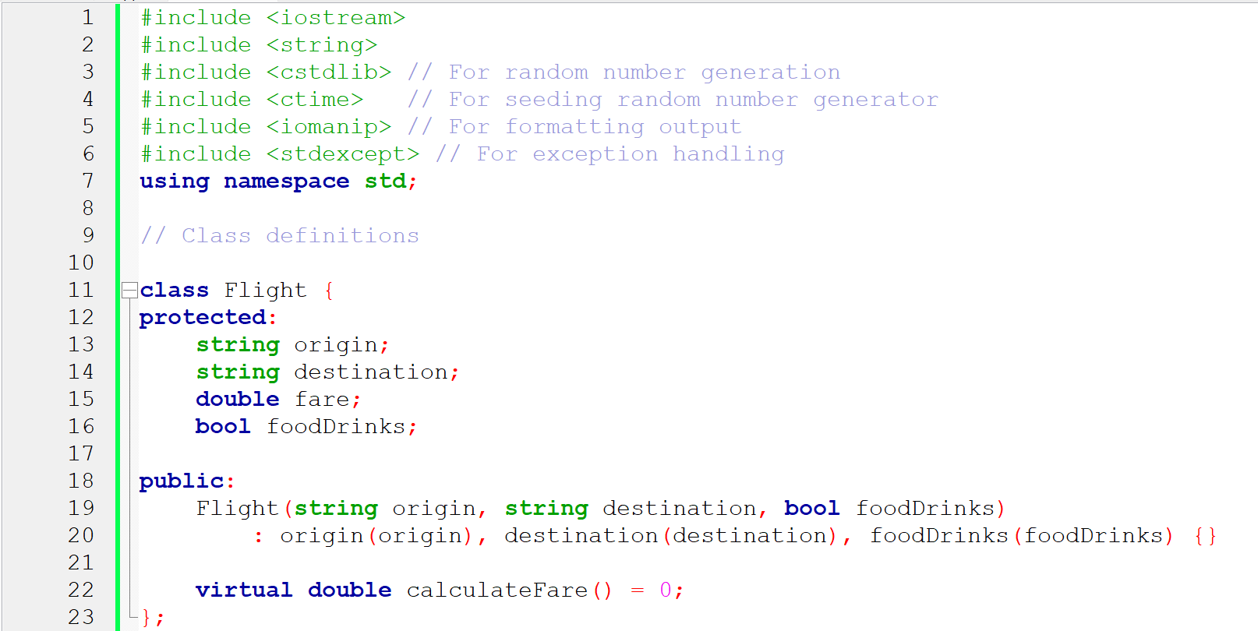
Code Snippet
School of Electronics and Communication Engineering

Slide 12
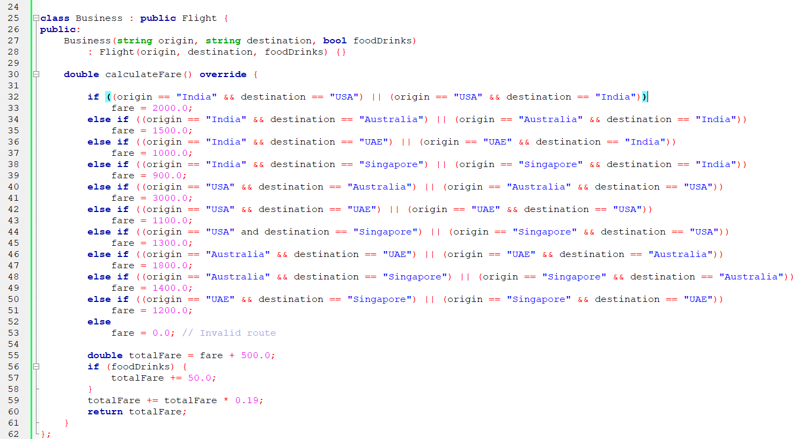
Code Snippet
School of Electronics and Communication Engineering

Slide 13
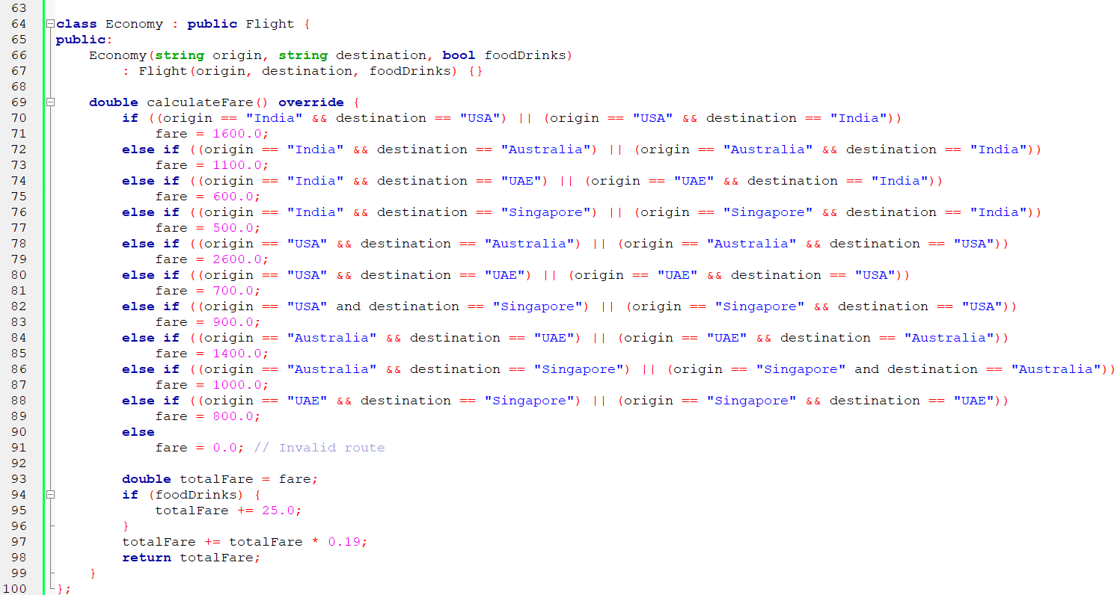
Code Snippet
School of Electronics and Communication Engineering

Slide 14
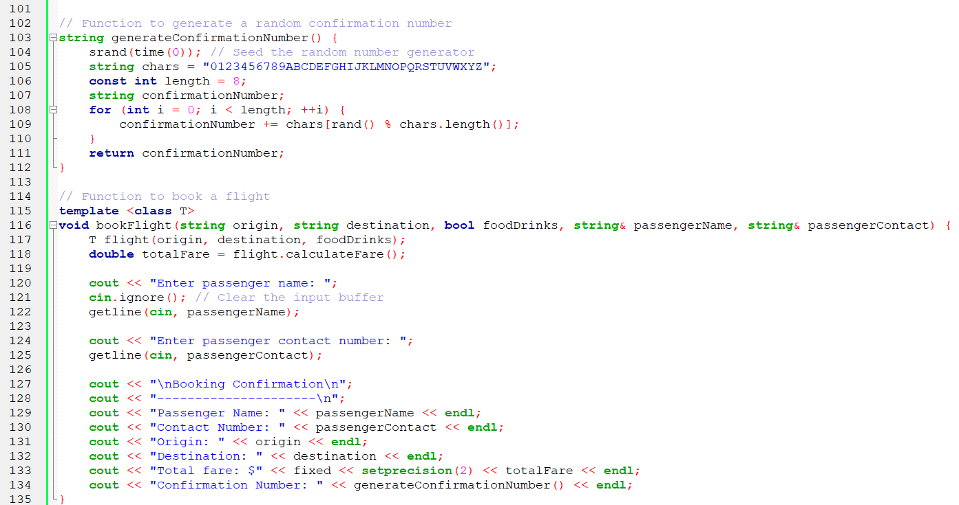
Code Snippet
School of Electronics and Communication Engineering

Slide 15
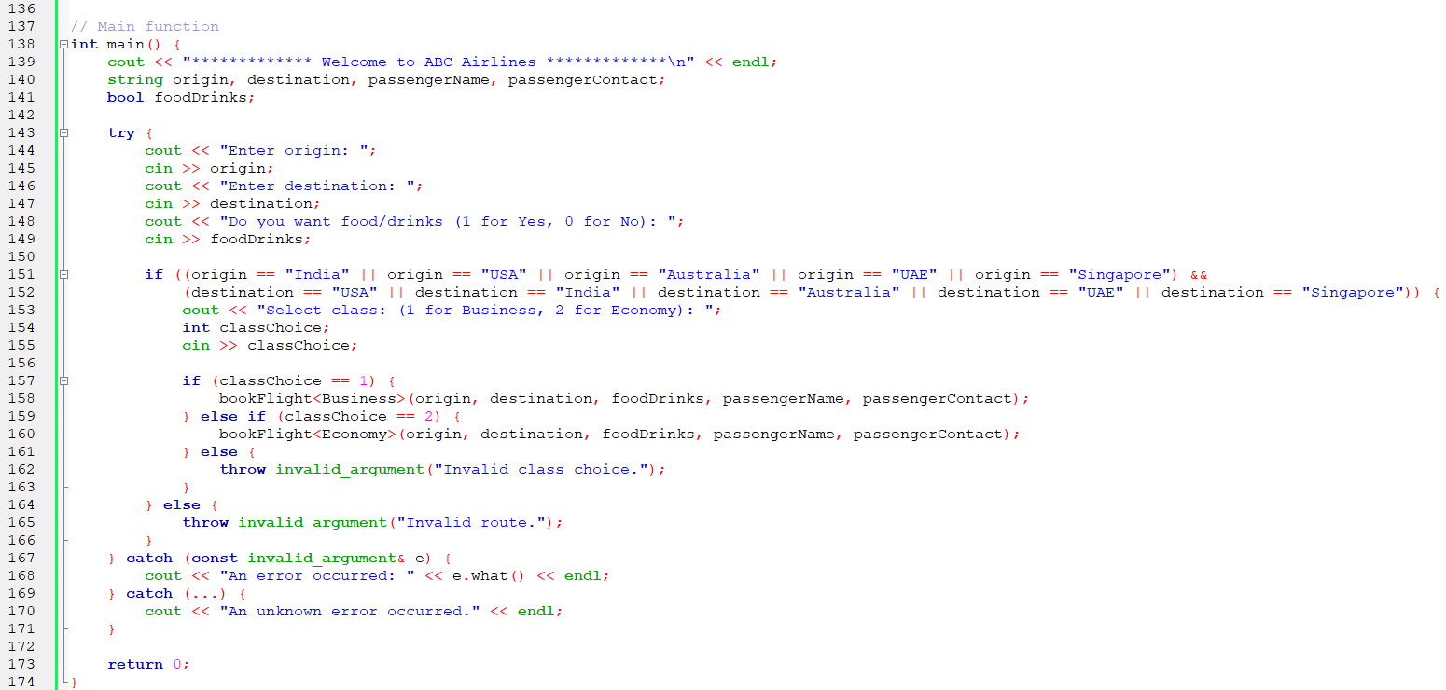
Code Snippet
School of Electronics and Communication Engineering

Slide 16
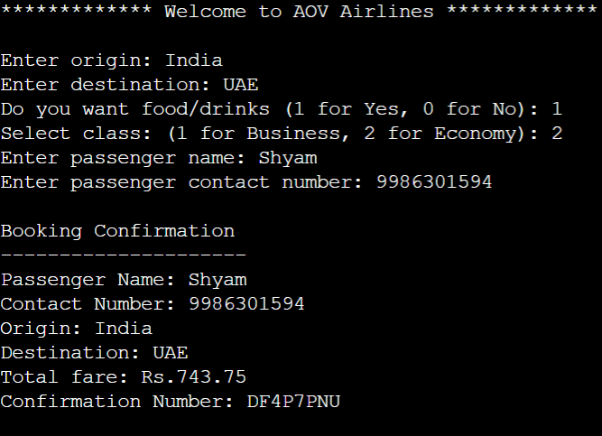
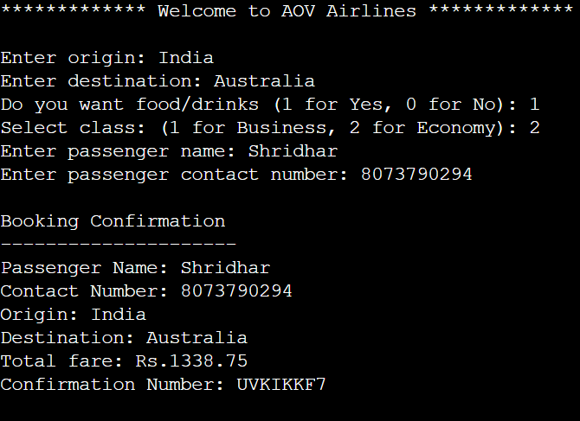
Results and discussions
School of Electronics and Communication Engineering

Slide 17
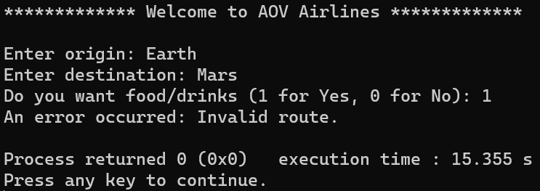
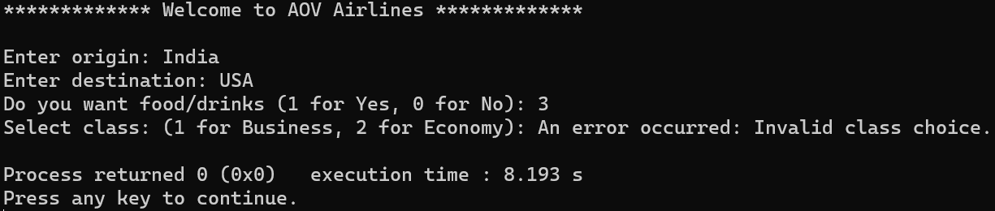
Results and discussions
School of Electronics and Communication Engineering

Slide 18
This project successfully implements a flight booking system. It achieves its objectives by delivering a seamless and user-friendly booking experience for passengers. It accurately calculates fares based on origin, destination, and class of travel, ensuring transparency and fairness. Effective exception handling is implemented to manage user inputs.
Conclusion
School of Electronics and Communication Engineering

Slide 19
THANK YOU
School of Electronics and Communication Engineering

